Slide 1
Results Presentation
Heyang Liu

Slide 2
Key Findings at a Glance
Unlike some previous literature suggesting an inverted-U pattern, we find a consistently negative relationship between Remittances/GDP and inequality.
Including macroeconomic variables significantly improves model fit, and shows the necessity of using education as control variables.
Basic education exhibits an inverted-U effect, while the nonlinear (U-shaped) impact of higher education becomes significant only after accounting for time fixed effects.

Slide 3
Methodology
We analyzed an unbalanced panel dataset of 558 observations from 72 countries between 1980 and 2015, using OLS and fixed-effects regressions to examine the relationship between income inequality and reliance on remittances (measured as remittances/GDP).
Control variables include education coverage and economic status of countries.
Time-fixed effects were incorporated using period-based groupings.

Slide 4
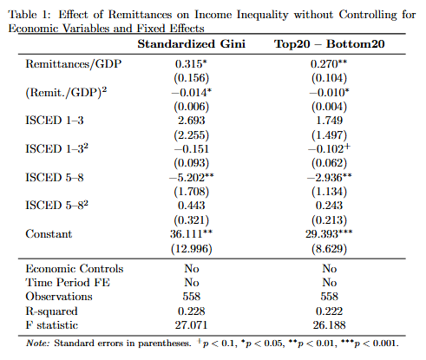
Simple model
Table 1 shows that remittances have a statistically significant inverted-U-shaped relationship with inequality. Higher education reduces inequality, while basic education shows no clear effect.
This result is consistent across both measures.

Slide 5
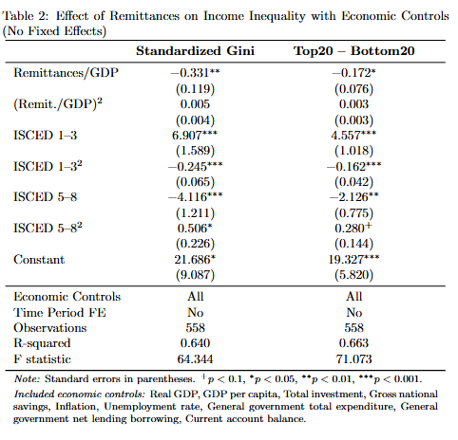
Economic controls
Table 2 adds economic controls and shows that the relationship between remittances and inequality becomes linear and negative.
The role of education becomes more prominent: basic education exhibits an inverted-U pattern, and the overall explanatory power improves substantially (R² increases from ~0.22 to ~0.64).

Slide 6
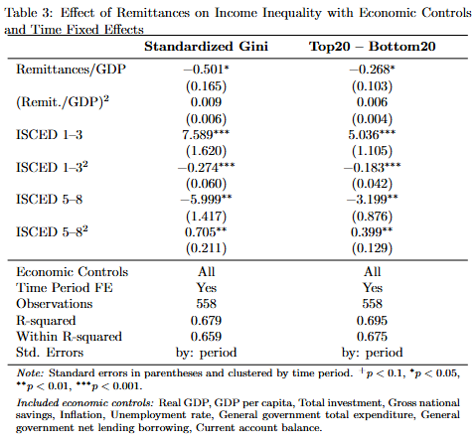
Time fixed effects
Table 3 incorporates time fixed effects and confirms the robustness of previous results: the relationship between remittances and inequality remains negative and linear, and ISCED 1–3 continues to exhibit an inverted-U shape.
While the U-shaped trend for ISCED 5–8 was already suggestive in earlier models, its effect becomes statistically significant with the inclusion of time fixed effects.

Slide 7
Reduced controls (robustness check?)
Based on the regression results from Table 2 (which includes only economic controls), a reduced model was estimated in Table 4, where only the control variables that are statistically significant were retained. In Table 5, time fixed effects are further applied.
The coefficients before and after the reduction remain in the same direction and have similar magnitudes, with only minor changes in significance levels.
The non-linear impact of higher education expansion becomes more evident after including time fixed effects, and this pattern is also observable in the reduced model.

Slide 8
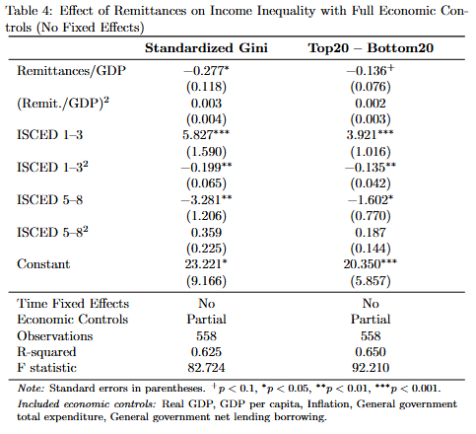
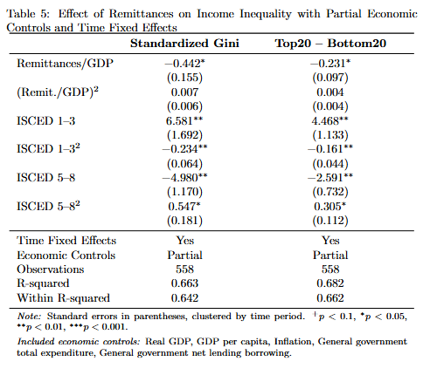

Slide 9
Summary
Reliance on remittances reduce inequality: The relationship is consistently negative and becomes clearly linear after controlling for economic conditions—contradicting prior inverted-U hypotheses.
Basic education has an inverted-U effect: ISCED 1–3 initially increases inequality but reduces it as access expands; this pattern becomes significant after including economic controls.
Higher education shows a U-shaped effect: ISCED 5–8 consistently lowers inequality, but its nonlinear (U-shaped) effect becomes statistically significant only after adding time fixed effects.
Results pass the robustness check

